Slide 1

User Data Ingestion (Node.js Backend)
How users provide data
Manual Property Entry
  File: /BACK/ariesview-backend/routes/property.js
  Endpoint: POST /api/property/add
  Example: when a user fills out “Property Name” or “Address” in the form, the backend validates fields (lines 129-134) and inserts them into the properties table.
Unit Information
  File: /BACK/ariesview-backend/routes/property_add.js
  Endpoint: POST /api/property_add/unit_add
  Loops through each unit in the request and writes to 6 tables (units, financial_leases, core_lease_information, etc.).
Financial Details
  File: /BACK/ariesview-backend/routes/property.js
  Endpoint: POST /api/property/property_details
  Functions like getGrowthValues() turn JSON growth arrays into usable year-by-year values, stored in PostgreSQL.

Slide 2
Document Processing & AI Integration (OCR + RAG)
What happens when documents are uploaded
Document Upload
  File: /BACK/ariesview-backend/routes/document.js
  Endpoint: POST /api/documents/properties/:propertyId/documents
  Files are stored in Azure Blob Storage using unique blob names (uuidv4() + original filename).
OCR Service
  File: /BACK/ariesview-backend/services/ocrService.js
  Calls external OCR at process.env.OCR_SERVICE_URL.
  Example: a rent roll PDF gets converted into structured JSON with tenant names and rent values.
AI/RAG Processing
  Repo: /DATA-AI/rag-pipeline/main.py
  Creates user-specific Weaviate collections (e.g., User_{user_id}) and stores vector embeddings.
  Embeddings built with HuggingFace sentence-transformers/all-MiniLM-L6-v2.
  Endpoint: POST /api/ai/rag-query lets users ask “What’s the loan term in this document?” and retrieve context-aware answers.

Slide 3
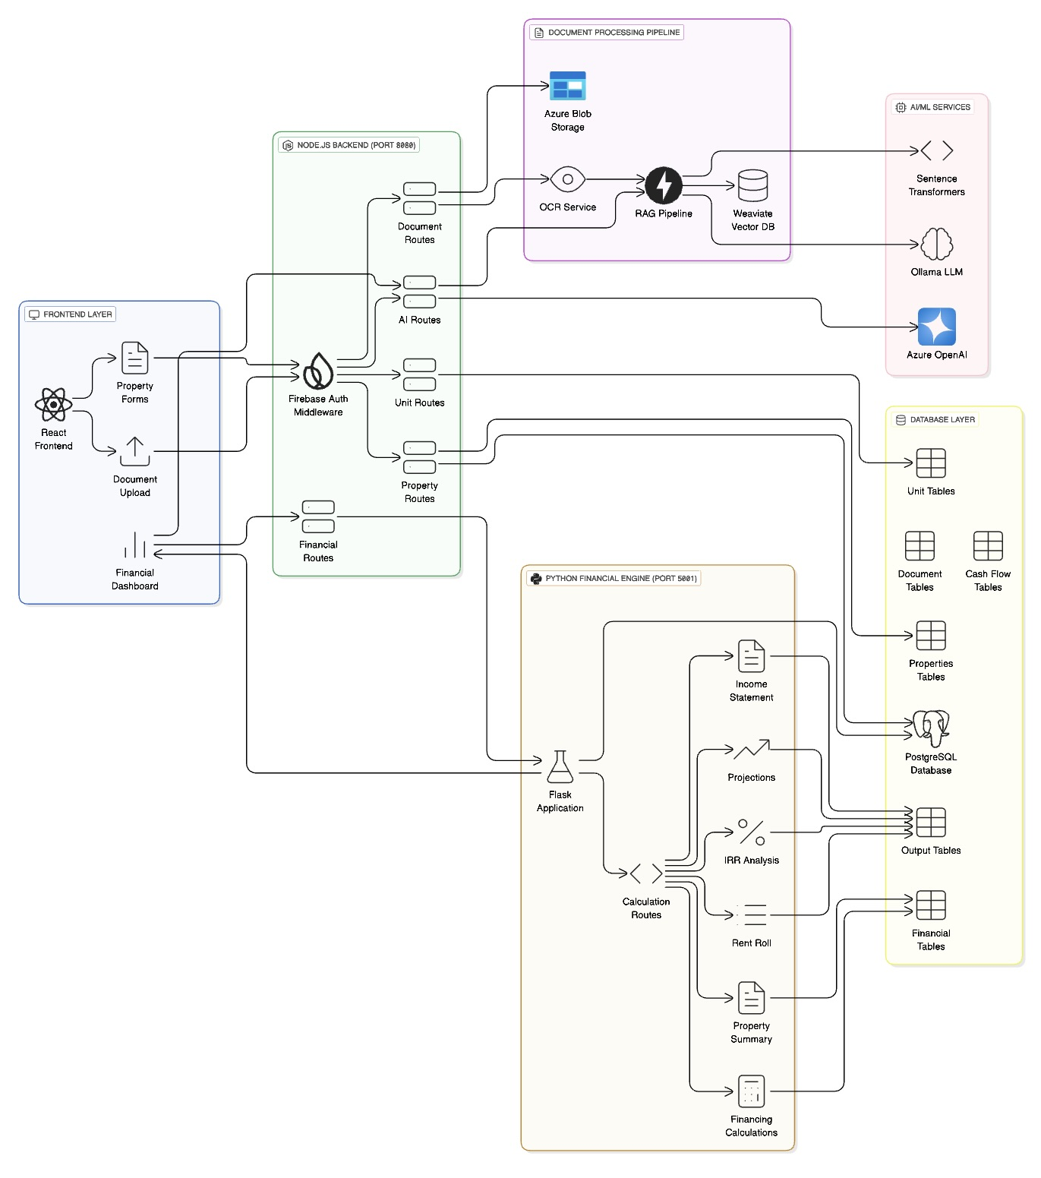

Slide 4
Financial Calculation Engine (Python/Flask Layer)
When calculations are triggered
Flask App Setup
  File: /BACK/financal-calculation/app.py
  Connects to PostgreSQL via SQLAlchemy; secures access with Firebase Auth.
Trigger Point
  File: /BACK/financal-calculation/routes/calculate.py
  Endpoint: POST /calculate/{property_id}
  Steps:
    Verify Firebase token.
    Fetch property + financial inputs from database.
    If results already exist, use cache. If not, run calculations.
Modules & Outputs
  property_summary.py: computes all-in basis, cap rates, $/SF.
  output2.py: builds 11–15 year projections → saved in income_statement_output2.
  output3.py: IRR analysis → saved in acquisition_model_output3.
  output5.py: unit-level rent roll projections.

Slide 5
Data Storage, Security, and Delivery
Where results live & how they are used
Database Tables
  Config: /BACK/ariesview-backend/config/database.js (Postgres pool)
  Key Tables:
    Inputs: properties, cash_flow_inputs, financial_assumptions
    Outputs: property_summary, income_statement_summary, acquisition_model_output3
Migrations
  File: /BACK/ariesview-backend/services/migrationScripts/dbMigrationService.js
  Automatically creates/updates tables like financial_income_items and financial_expense_items.
Security
  Firebase ID tokens isolate user data.
  SAS tokens secure Azure Blob access.
  All queries filter by firebase_uid.
Final Outputs
  Reports – exported PDFs/Excel models.
  Dashboards – KPIs and cash flow visualizations.
  APIs – structured JSON responses for the frontend.
End-to-End Story:
Inputs (manual + docs + AI) → Validated/Stored in DB → Python Engine Calculates → Results saved → Outputs delivered securely to users.

